Slide 1
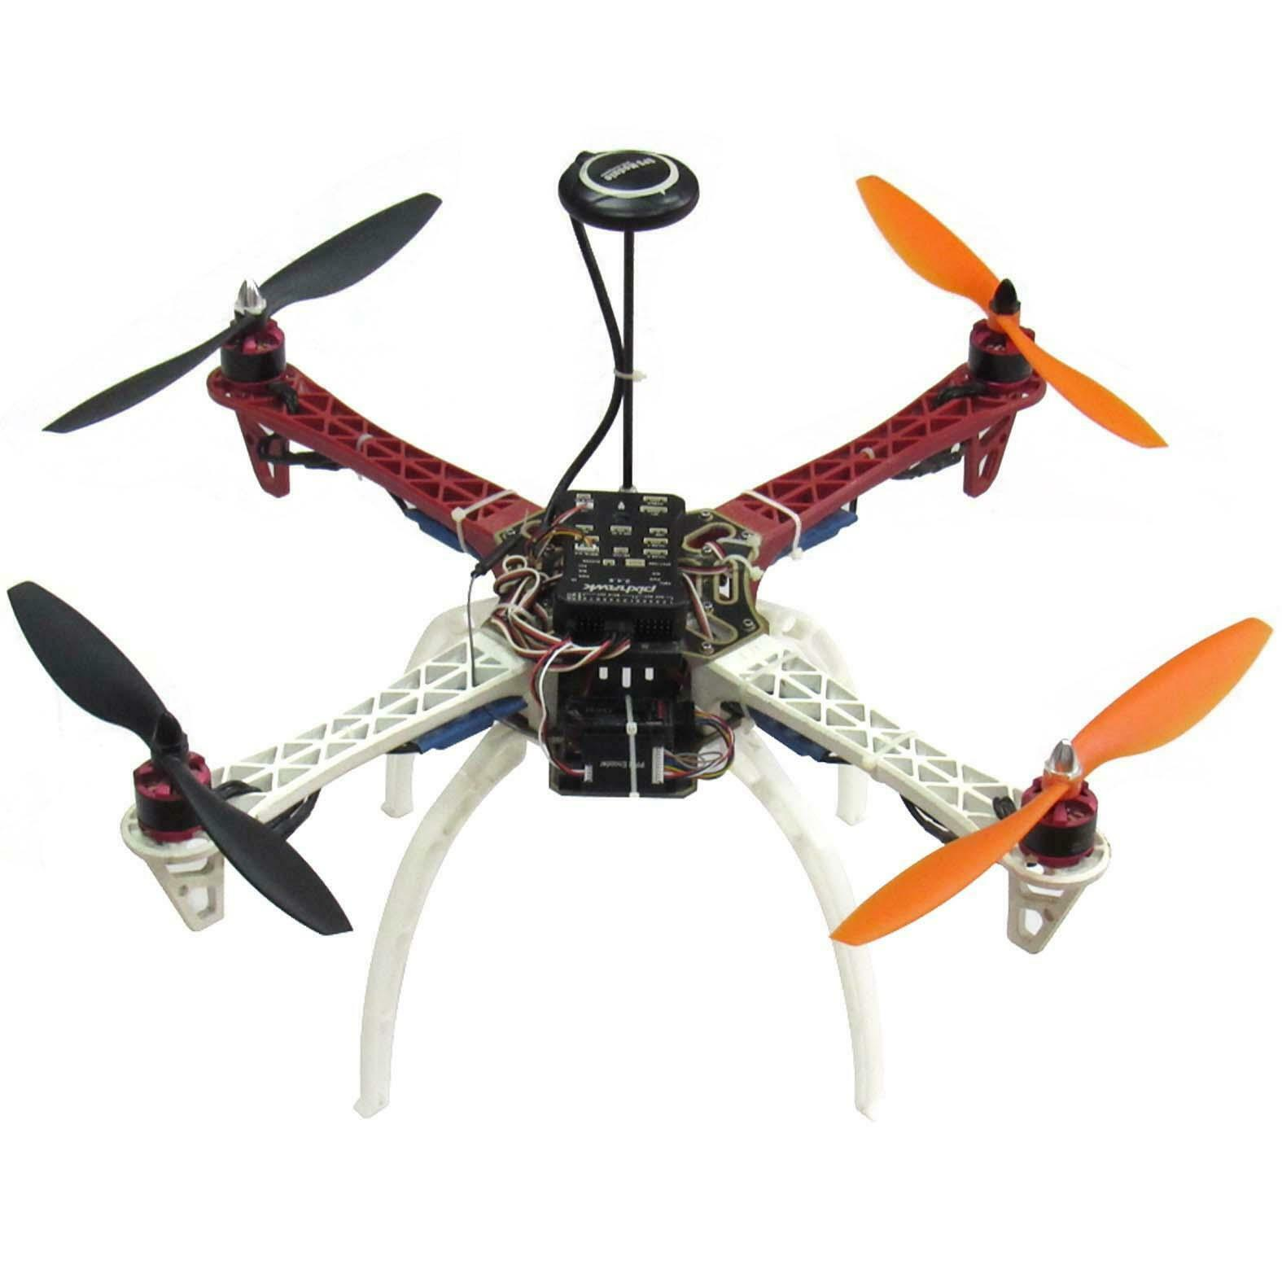

Intro to Ardupilot and PX4 (Part 1,2&3)
Reference: Circuit Cellar
Today’s Date: April 11, 2022
CC-2020-04-Issue-357

Slide 2
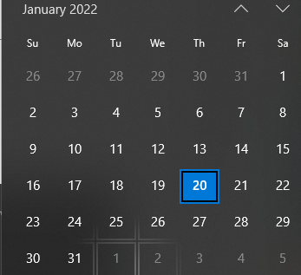
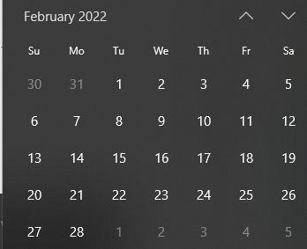
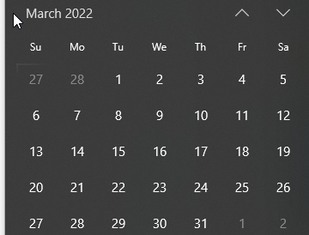
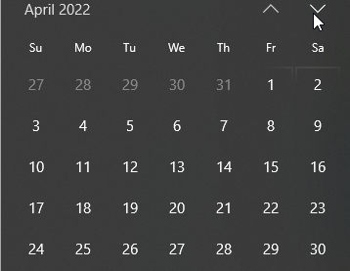

Spring 2022 Calendar M 7:40pm-9:40pm (1/24 to 5/14)
ML and AI for Vision
SW+HW Setup.+ Basic Tutorials
Spring Break
Public holiday
A2
proposal
Line Following and
Vehicle Tacking and Detection
DGMD E-17
Section 1, CRN 26008
Robotics, Autonomous Vehicles, Drones, and Artificial Intelligence
Participation Option: Either Live via Web Conference or On Demand Online
A3
Final Presentations
A4

Slide 3
Part 1. Drone Autopilot Solutions
Introduction
general architecture of a multirotor drone system for aerial photography
THE FLIGHT CONTROLLER
STABILIZATION
FRAME AND PROPULSION SYSTEM
POWER, RC AND TELEMETRY
AERIAL PHOTOGRAPHY HARDWARE
Ground Control Station (GCS) software
ARDUPILOT AND PX4 PLATFORMS
THE MAVLINK PROTOCOL

Slide 4
Drone Autopilot Solutions Introduction
Ardupilot and PX4 are two opensource autopilot platforms regarded as the leading flight controller platforms for small unmanned vehicles in a wide variety of applications, including hobby and amateur, commercial, industrial and academic research.
The Ardupilot and PX4 open-source autopilot platforms are two of the most popular flight controller platforms for drones. In Part 1, we will be discussing the general architecture of a do-it-yourself, multirotor drone and its main software and hardware components.
Then, We will provide a general introduction to both the Ardupilot and PX4 platforms, and discuss some examples of supported flight controller hardware, vehicle types and available ground control software. We will also give a general introduction to the MAVLink protocol used in both platforms for communication of vehicles with ground control stations.
Open Source Autopilot for Drones - PX4 Autopilot
ArduPilot - Versatile, Trusted, Open

Slide 5
Intro part 2
In Part 2, we’ll discuss how to build a quadrotor for aerial photography, based on one of the aforementioned platforms. We will also present a setup that, with minor modifications, could also be used as a starting point for future experimentation with autonomous navigation and computer vision-based object tracking.
The information presented here is aimed mainly at students and hobbyists who want to start building multirotor drones with open-source Ardupilot and PX4 software and hardware, but don’t have a general background in multirotors and the platforms.
By the end of this presentation, the necessary information will be presented to understand the general architecture of a multirotor and choose one of the two platforms for building a drone for aerial photography

Slide 6
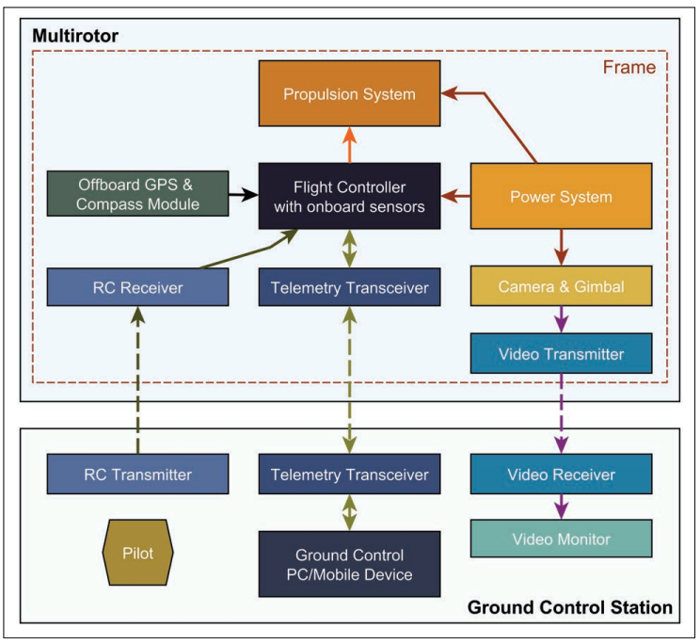
general architecture of a multirotor drone system for aerial photography
Figure 1 is a block diagram depicting the general architecture of a multirotor drone system for aerial photography. It comprises the following main components: a frame, a flight controller with onboard and offboard sensors, a propulsion system, a power system, a radio control (RC) transmitter/receiver pair, telemetry transceivers, a video camera with a gimbal, a First Person View (FPV) system with a video transmitter, receiver and monitor and ground control software, typically running on a personal computer or mobile device. Let’s look at each component in more detail.

Slide 7
THE FLIGHT CONTROLLER
The flight controller is generally a microcontroller (MCU)-based board with firmware specially written for stabilizing and controlling the flight of the aircraft.
It has attached onboard and offboard sensors, from which it takes readings and uses that data to try to infer the aircraft’s pose (position and orientation). Then, with the help of a sophisticated control algorithm, it tries to stabilize the aircraft and make it maintain its actual pose, or drive it to a new desired one. It achieves stabilization by constantly comparing its actual pose (inferred from its sensors) and the desired pose (where it wants to be). Based on that information, it decides how much thrust it must apply to all its rotors to correct its pose. Sensors frequently found in typical flight controllers are: 3D accelerometers and gyroscopes, altimeter (pressure sensor), digital compass (magnetometer) and a GPS receiver. Although in practice, only a 3D gyroscope is needed to keep a multirotor aerodynamically stable (hovering in the air), the other sensors are required to make possible more advanced functionality, such as maintaining a given position, orientation or velocity, flying GPS waypoints and so on.

Slide 8
STABILIZATION
Multirotors are inherently aerodynamically unstable, and it is very difficult to stabilize them by manually controlling the thrust of their rotors. For that reason, an electronic flight controller is required to stabilize a multirotor aerodynamically. The flight controller can execute a control loop (that is, read its sensors, compute errors and take the necessary correction measures) at a high frequency. In contrast, fixed-wing drones (“planes”) are inherently aerodynamically stable, and can be flown by controlling manually their motor thrust and control surfaces. Therefore, flight controllers are optional for stabilizing fixed wings, but they are still required for more advanced functions, such as maintaining a given trajectory or flying automated GPS waypoint missions.

Slide 9
STABILIZATION
The embedded software for a flight controller is not trivial. Usually it contains, at its core, sophisticated algorithms used in autopilots, such as nested PID control loops for controlling 3D attitude, and velocity and Kalman filters for sensor fusion. However, the firmware, which is a precompiled binary of the autopilot software, is generally available directly to be loaded to the flight controller board.

Slide 10
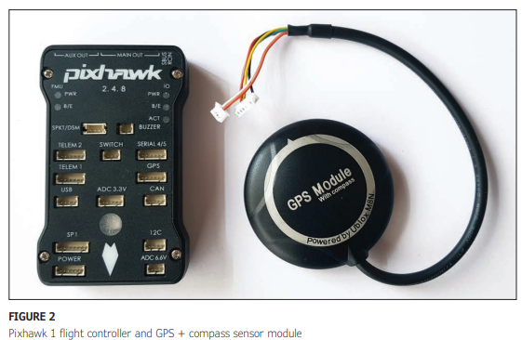
STABILIZATION
Figure 2 shows the Pixhawk 1 flight controller board, along with a GPS receiver and digital compass sensor module. (Both the GPS receiver and compass come inside the round case.) The Pixhawk 1 is very affordable (around $75) and is compatible with Ardupilot and PX4. It is based on the STMicroelectronics

Slide 11
STABILIZATION
STM32F427 Cortex-M4F 32-bit MCU, and comes with several onboard sensors. They are an L3GD20H 16-bit gyroscope and a LSM303D 14-bit accelerometer/ magnetometer (both also made by STMicroelectronics), one Invensense MPU6000 3-axis accelerometer/gyroscope and one MEAS MS5611 barometer from TE Connectivity. The external GPS/compass module has a Ublox M8N GPS receiver and a Honeywell HMC5883L digital compass.

Slide 12
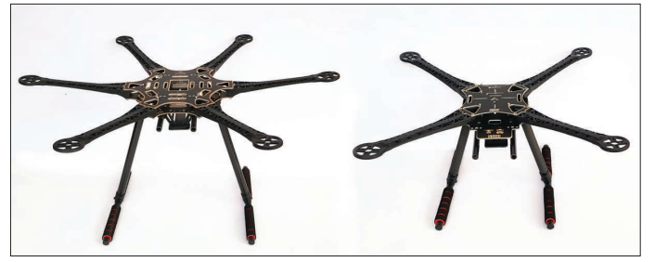
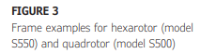
FRAME AND PROPULSION SYSTEM
Figure 3 shows two example frames for a hexarotor (frame model S550) and a quadrotor (frame model S500). The main purpose of a frame is to hold all hardware parts that fly with the aerial vehicle. The propulsion system, in contrast, comprises all parts directly in charge of generating lift for the aerial vehicle. They are a set of brushless motors, propellers and Electronic Speed Controller (ESC) units in the required number for the selected configuration (four for a quadrotor, six for a hexarotor, and so on).

Slide 13
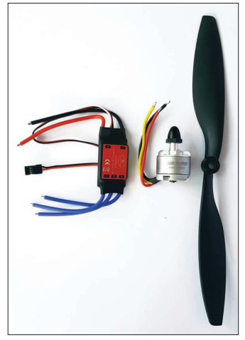
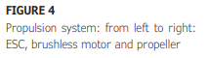
FRAME AND PROPULSION SYSTEM - brushless motor
A brushless motor, known also as electronically commutated or synchronous DC motor, is controlled by a current pulse signal from the ESC. It is characterized mainly by four specifications: size, rotation velocity, maximum working voltage and power. For example, a “2212, 920KV, 4S, 150W” brushless motor has a diameter of 22mm and a height of 12mm (hence, 2212). It spins at 920KV (which is really 920rpm/V), and can be powered with Lithium-ion polymer (LiPo) batteries up to 4 cells (or any equivalent power supply). A LiPo battery has a nominal voltage of 3.7V per cell, so a 4S battery has a total nominal voltage of 3.7V × 4 = 14.8V. This means that this particular motor can be powered with any voltage up to 14.8V, nominally. Last, the power specification gives us the maximum current the motor can handle safely.

Slide 14
FRAME AND PROPULSION SYSTEM - Propellers
Propellers are characterized mainly by diameter and pitch. For example, a “1045” propeller has a diameter of 10” and a pitch of 4.5”. For two-blade propellers, the diameter is the size between the tips of the two blades. The pitch, however, has a meaning seemingly more “obscure” at first, especially for newcomers. It is the longitudinal distance a propeller would move forward in one revolution, as if it were a screw going into wood [1]. Both diameter and pitch must be appropriately combined, according to velocity and power specifications for a given motor. As a rule of thumb, large-diameter and low-pitch propellers are required for lowvelocity motors, which, in turn, provide more torque—characteristics typically desired for drones that lift high payloads. Wen contrast, low-diameter and high-pitch propellers are required for high velocity motors, which make the aircraft faster and more maneuverable, but with lower motor torque and less payload capacity. The latter characteristics typically are required for racing drones.

Slide 15
FRAME AND PROPULSION SYSTEM - “reference design” kits
In general, however, we don’t have to worry much about these specific details, because for building our first multirotor, we generally take one of a few “reference design” kits widely available for purchase.
They have all the right parts with the right specifications for a given application, whether for racing, photography or carrying high payloads. Propellers come in a variety of materials, most commonly plastic, reinforced fiberglass, carbon fiber and wood. The plastic ones are cheaper and low quality, and the wood ones generally are more expensive but with better quality. A good mix of low price and reasonable quality would be the reinforced fiberglass or carbon fiber propellers.

Slide 16
FRAME AND PROPULSION SYSTEM - “reference design” kits
The ESC, as its name implies, controls the motor speed. An ESC receives a PWM signal (identical to a servo motor control signal) at its input and provides in response a triphasic voltage signal to drive the brushless motor. It uses field-effect transistors (FETs) to produce high-current switching signals with a duty cycle proportional to the required velocity.
ESCs are characterized mainly by the maximum current they can source and the maximum battery voltage they can work with. A “30A, 5S” ESC for example, will handle up to 30A of current and work with batteries up to 5 cells in series (18.5V, nominal voltage).
Most ESCs include a Battery Elimination Circuit (BEC) unit, which is just a fancy name for a voltage regulator that provides a 5V output to power some other electronic devices in a drone, such as servo motors and small video cameras.
There are also opto-isolated ESCs (OPTO ESCs), which have the input signal-receiving circuitry optically isolated from the higher output voltage circuit that powers the motor. This type of ESC typically doesn’t have BEC units included, but if needed, BECs can be purchased separately as standalone units

Slide 17
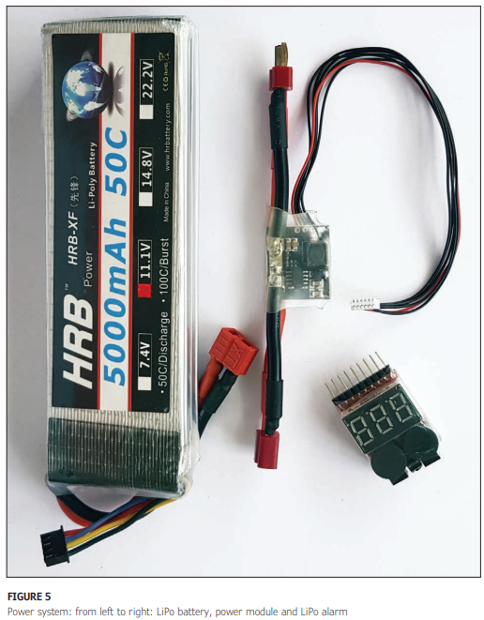
POWER, RC AND TELEMETRY
The power system comprises a LiPo battery pack, a power module and optionally a battery alarm. Figure 5 shows them from left to right, in that order. LiPo batteries are usually characterized by three main specifications—capacity, voltage and discharge rate. For example, for a typical quadrotor for aerial photography a “5000mAhour, 3S, 8C” LiPo battery can be used. 5000mA-hour capacity means that the battery can provide a sustained current of 5,000mA (or 5A) for 1 hour, or alternately 10A for half an hour, or 20A for 15 minutes. 3S means that the battery has 3 LiPo cells connected serially, for a total nominal voltage of 11.1V (3.7V x 3 = 11.1V). The discharge rate 8C, if multiplied by the capacity, specifies the battery’s continuous discharge rating. Multiplying 5,000 times 8, gives 40,000mA, or 40A of continuous discharge current rating. This means the battery can give continuously up to 40A of current safely, without suffering any damage

Slide 18
POWER, RC AND TELEMETRY
The power module is basically a 5V regulated power supply with included voltage and current sensors. It takes the battery voltage (for example 11.1V for a 3S battery) as input and provides a regulated 5V output to power the flight controller and onboard sensors, along with any other external device connected to the flight controller. Examples of such external devices include offboard sensor modules, the RC receiver, and the telemetry transceiver. The flight controller can read from the included voltage and current sensors the drone’s actual voltage and current consumption and use this data to estimate the remaining battery power and also the available flight time.

Slide 19
POWER, RC AND TELEMETRY
As for the LiPo alarm, it is basically a voltmeter with a buzzer. It constantly measures the voltage in each cell of the battery, and provides an audible alarm beep when the cells reach the minimum allowed voltage (about 3V) per cell. So, the main task of the LiPo alarm is to warn us when the battery has reached the minimum permissible voltage before over-discharge—which can irreversibly damage the battery--occurs. The voltage and current sensors present in the power module basically fulfill this same task, if appropriately configured with in the flight controller. In this case, the external LiPo alarm would become redundant. LiPo battery cells have a maximum cell voltage specification too, which is 4.2V for a fully charged cell. This means a fully charged 3S battery really has 12.4V, higher than the nominal 11.4V [2].

Slide 20
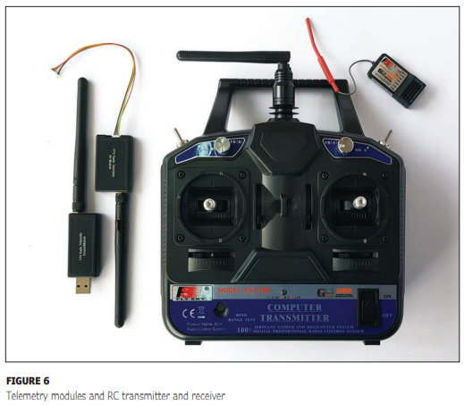
POWER, RC AND TELEMETRY
Let’s talk now about the telemetry modules and RC system shown in Figure 6. The RC system (the large and small objects on the right in Figure 6) comprises a transmitter and receiver pair working in the 2.4 GHz bandwidth (the most popular working frequency for RCs). A system with at least four channels is required for basic flying of a multirotor, and a minimum of six channels is needed to include some advanced functions, such as multiple flying modes and some GPS based flying functions. If you can afford them, nine or 10 channels are recommended for maximum versatility. Telemetry modules (the two objects on the left in Figure 6), as the name implies, help us receive from the drone radio telemetry data in a personal computer or mobile device. They also allow us to remotely change some configuration parameters in the flight controller, and to perform advanced functions, such as sending and triggering GPS waypoint navigation missions. Common telemetry modules are available for working in the 433MHz and 915MHz bandwidths. You must choose the legally permitted one in your country, in compliance with local regulations

Slide 21
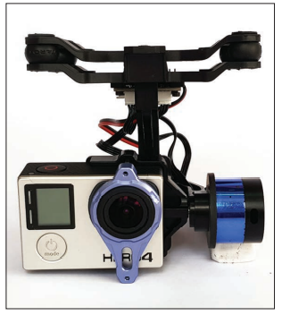
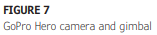
AERIAL PHOTOGRAPHY HARDWARE
A typical aerial photography quadcopter, such as the one we will build in Part 2 of this presentation series, has a payload capacity of around 500g on average. Cameras designed for recording sports action, and cameras specifically designed for drone photography are commonly used, because they are small and low-weight (around 130g). These cameras can store video images and photos locally in a micro SD card, but also provide a live output video feed, which can be wirelessly transmitted and monitored in real time using an FPV system. Some cameras have internal rechargeable batteries, so they don’t need external power, and some can be powered directly from the LiPo pack. Figure 7 shows a GoPro Hero camera mounted in a Tarot TL68A00 compatible gimbal. The gimbal is an autoleveling mechanism that helps the camera stay horizontally and vertically level, even if the drone is not. It has sensors, such as accelerometers and gyroscopes, which, in conjunction with an MCU, stabilize the camera, in a way similar to how the flight controller stabilizes the drone, itself. The gimbal can be powered directly from the LiPo battery pack that powers the drone’s propulsion system.

Slide 22
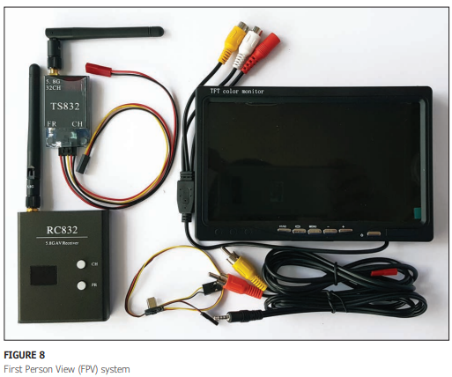
AERIAL PHOTOGRAPHY HARDWARE
Finally, the FPV system (Figure 8) is a wireless video transmission, reception and monitoring system that works commonly in the 5.8GHz bandwidth. It comprises a video transmitter (upper left in Figure 8) connected to the video output feed of the camera, and a receiver (lower left) connected to a video monitor (to the right). The monitor is located near the pilot at the ground control station. The transmitter can be powered from the main battery pack, whereas the receiver and video monitor generally have their own LiPo battery for portability.

Slide 23
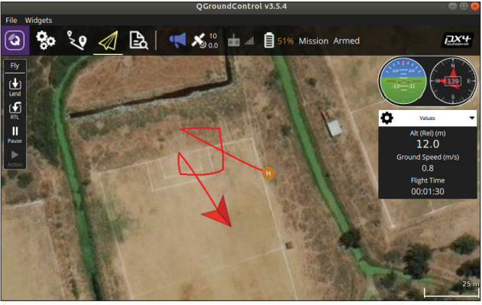
ground Control Station (GCS) software
Ground Control Station (GCS) software is a software application that runs on a personal computer or mobile device and performs a variety of functions: It allows a user to program the firmware in the flight controller board, configure its parameters, calibrate the sensors and configure the RC system, among other things. It also displays the drone’s telemetry data in real time (for example, position and velocity), and makes it possible to control the drone remotely, modify its parameters and trigger some special functions—such as autonomous GPS waypoint navigation and automatic return to home. It also allows monitoring of the drone’s global position in a map and sometimes monitoring live video streams from the drone’s camera. Figure 9 shows a screen capture of QGroundControl, a well-known GCS software that can run on both personal computers and mobile devices. The screen capture shows the drone’s position and orientation in a map, its followed path, some telemetry data, and a navigation instrumentation panel in the manner of a “virtual cockpit”.

Slide 24
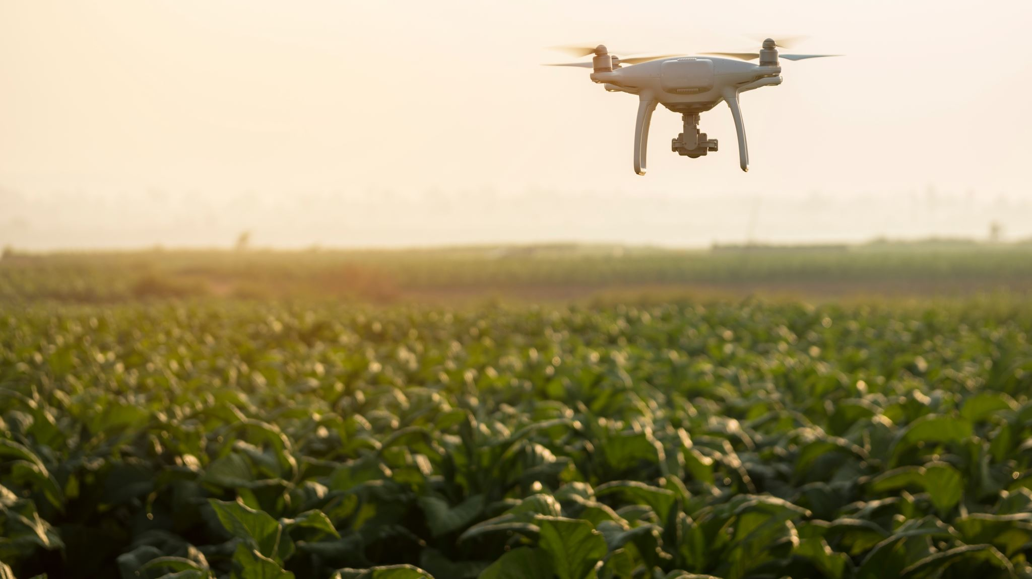
ARDUPILOT AND PX4 PLATFORMS
Ardupilot [3] and PX4 [4] are two of the most commonly used open-source drone platforms for diverse applications, such as hobby and entertainment, professional photography, aero photogrammetry, multispectral remote sensing, cargo delivery, and research and development. Both platforms have a complete ecosystem of tools that includes flight controller boards with a variety of supported sensors, autopilot firmware for different types of vehicles and configurations, ground control software and SDKs/APIs for controlling drones programmatically and developing drone applications. Wen the remaining paragraphs, We will talk about some of the supported flight controller boards and ground control software in both ecosystems. Then We will briefly explain about the MAVLink protocol used in both platforms for telemetry and control.

Slide 25
ARDUPILOT AND PX4 PLATFORMS
Flight Controllers: The Ardupilot platform supports a wide variety of open-source and closed-source flight controller hardware. Some of the open-source ones are: Pixhawk 1, Pixhawk 3, Pixracer, CUAV V5, Cube, Beaglebone Black and PocketBeagle. The last couple require sensor add-on boards or “capes.” Some of the closed-source options are: Pixhawk 4, Kakute F4/F7, NAVIO2, VR Brain, VR uBrain, Parrot C.H.U.C.K, and Parrot Bebop Autopilot [5]. Although there are some others, We’m mentioning only those We know most.
There’s available firmware that runs on these hardware platforms to support multiple types of vehicles, such as multirotors, fixedwing and VTOL (Vertical Take Off and Landing) aircraft, helicopters, ground rovers, boats, submarines and even antenna trackers. Precompiled firmware for all these types of vehicles is generally available directly from ground control software to be easily uploaded to the flight controller board. The firmware is highly configurable via a plethora of parameters that control many things— from low-level configuration of sensors and actuators to the tuning constants of stabilization PID control loops.

Slide 26
ARDUPILOT AND PX4 PLATFORMS
Depending on the type of vehicle, the Ardupilot firmware supports a variety of sensors from the most common ones used for basic flight control and stabilization (gyroscopes, accelerometers, compass, altimeter and GPS), to some complementary sensors that allow enhanced functionality (sonar, laser, optical flow and airspeed sensors). Some sensors are included in the flight controller board along the MCU (onboard sensors), and some are attached externally (offboard sensors).

Slide 27
ARDUPILOT AND PX4 PLATFORMS
Some functions commonly available to all vehicles in both platforms include: manual, semi-autonomous and fully autonomous flight modes; programmable 3D waypoint navigation missions; fail safes for loss of RC communication; GPS glitches and low battery power level; support for camera gimbal; radio telemetry; companion computer integration and software simulation

Slide 28
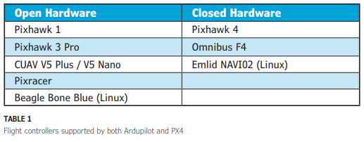
ARDUPILOT AND PX4 PLATFORMS
PX4 also has various kinds of supported flight controller hardware [6], and supports vehicles, such as multicopters, helicopters, airplanes, VTOL aircraft and ground rovers. Almost all functionality and characteristics mentioned for Ardupilot apply also to PX4. A list of open- and closed-hardware flight controllers officially supported by both Ardupilot and PX4 at the same time is given in Table 1.

Slide 29
ARDUPILOT AND PX4 PLATFORMS
Ground Station Software: Several ground control applications are available for the most common operating systems (Windows, Linux, Mac OS X, Android and iOS). Some of them are open source and some have proprietary licenses. For personal computers there are, for example, Mission Planner, APM Planner 2.0, MAVProxy, UgCS and QGroundControl. For mobile devices there are Tower, AndroPilot, MAV Pilot 1.4, SidePilot and QGroundControl (mobile version). All of them offer more or less the same functionality—firmware programming in the flight controller board, configuration of vehicle parameters, sensor calibration, RC system configuration and calibration, telemetry monitoring, flight mode management, 3D waypoint navigation and mission control, vehicle global position visualization on a map, FPV video monitoring, and others.

Slide 30
ARDUPILOT AND PX4 PLATFORMS
In general, all can be used with flight controller hardware and firmware from both Ardupilot and PX4, because all of them use the MAVLink protocol to communicate with vehicles, to send commands and receive telemetry and parameter data. However, it is possible that some MAVLink message types may not be implemented in some ground control software or the flight controllers, themselves.

Slide 31
THE MAVLINK PROTOCOL
MAVLink (Micro Air Vehicle Link) is an efficient telemetry protocol for communicating with small unmanned vehicles [7], which typically are resourceand bandwidth-constrained systems. It has two major versions, v1.0 and v2.0. The latter is backwards compatible with the former. With the risk of oversimplifying a bit, it can be said that the protocol works basically on two “modes”: multicast publish/subscribe, and point-to-point guaranteed delivery transmissions. The first mode is typically used for sending telemetry data streams from drones to ground control stations, onboard computers and cloud systems. The second is typically used for transmitting data and commands that require guaranteed delivery, such as when changing system configuration parameters in the vehicle or configuring onboard GPS navigation missions

Slide 32
THE MAVLINK PROTOCOL
By mixing both modes, MAVLink achieves high efficiency. A protocol frame in v2.0 has just 14 bytes of overhead, and a maximum of 27 bytes if message authentication is used. It can support up to 255 concurrent systems that can include vehicles, ground control stations, antenna trackers and so on. It has been implemented in other flight controller platforms, besides Ardupilot and PX4, such as: AutoQuad 6 AutoPilot, iNAV and SmartAP Autopilot, along with other ground stations, such as Side Pilot, JAGCS, Flightzoomer, Wenexa Control, Synturian Control and some QGroundControl variants (AutoQuad GCS, SmartAP GCS, Yuneec Datapilot, Sentera Groundstation, WingtraPilot).

Slide 33
THE MAVLINK PROTOCOL
High-level APIs/SDKs are also available that support the protocol for developing drone applications, such as MAVSDK (written in C++ with bindings to Python, Swift, Java and JavaScript), MAVROS (an ROS-to-MAVLink bridge), DroneKit (which supports Python and Android) and Rosetta Drone, which is a MAVLink wrapper to fly DJI drones with MAVLink-based ground control software.
Wen Part 2, we describe how to build a quadcopter with Ardupilot or PX4. We’ll discuss some similarities and differences between both platforms relevant to the build, and expand a bit about their APIs for coding drone applications. We will also talk briefly about how we can make the quadcopter fly autonomously.

Slide 34
Part 2. Building the Drone
0) Introduction
1) the hardware build;
2) flight controller firmware programming and configuration;
3) Electronic Speed Controller (ESC) calibration and pre-testing; and
4) flight test(s).

Slide 35
Introduction
In Part 1 of this presentation series last month, We discussed the general architecture of a DIY multirotor drone and its main hardware and software components. We also gave a general introduction to the Ardupilot and PX4 platforms, discussing some examples of supported flight controller hardware and vehicle types, as well as available ground control software from both platforms.
Additionally, We provided a general introduction to the MAVLink protocol used to communicate vehicles with ground control stations in both platforms. In this second part, We will discuss the main steps involved in the building and configuration of a DIY quadrotor with the PX4 platform.
Wet will not be a complete tutorial, but a review of the most important steps involved. We will also give some tips that address potential problematic situations in the build process that are not always immediately obvious for beginners.

Slide 36
There are a lot of well documented tutorials out on the Internet. Consider this presentation a summary of steps and important tips from my own experience, for beginners who want to build their first quadrotor. At the end, We will also share additional tips on how to get started with autonomous flight by using the MAVSDK library and MAVROS package.
Let’s see if, with this presentation, We can encourage you to build your first quadcopter, and begin to experiment with autonomous flight in the near future.

Slide 37
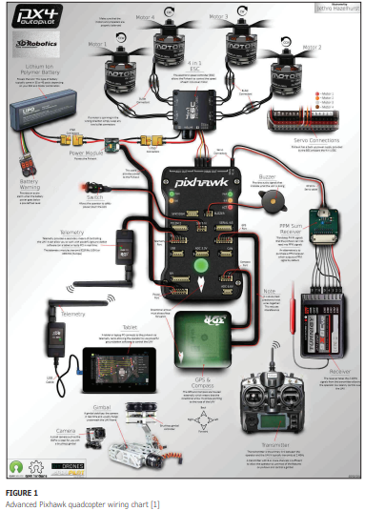
Figure 1 shows an amazing wiring chart made by Jethro Hazelhurst for the Ardupilot website [1].
To see greater detail, you can check the original version by using the link in the figure caption. Analyze the picture in detail.
It will be instructive if you have never built a quadcopter before.

Slide 38
The build process for a typical quadrotor— like the one We will show as an example in this presentation—is practically the same for both the PX4 and Ardupilot platforms. For this summary, We will use the PX4 platform to explain the process. So, what steps are generally involved in building, configuring and flying a quadcopter? We divide the process in four sections:
1) the hardware build;
2) flight controller firmware programming and configuration;
3) Electronic Speed Controller (ESC) calibration and pre-testing; and
4) flight test(s).
Within each of those sections are several steps.
The following development assumes you are already familiar with the main parts used to build a multirotor.

Slide 39
So, here is one of the first tips We would give to anyone doing their first quadrotor build. Tip #1: Never rush with any steps involved in the process, always double-check everything you do, and when in doubt, it is always better to do further research or ask anyone who’s more knowledgeable before proceeding.

Slide 40
THE HARDWARE BUILD
Step 1: The Frame. You’ll generally begin by building the frame. Frames come with a build instructions chart, or you can easily find one on the Internet. Just don’t tighten the screws hard the first time. We highly recommend that you build the frame first, just to “present” it.
Tip #2: For the first builds, it is better not to tighten the screws tightly at first, or to use threadlocker glue. Leave that for the final steps, after you are sure everything is correct and in place

Slide 41
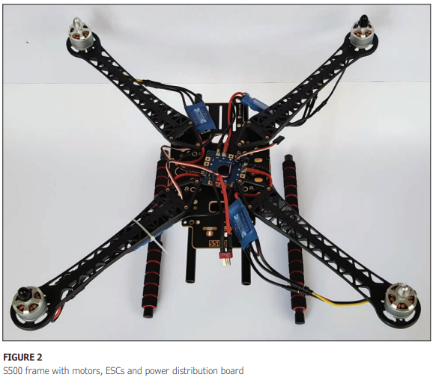
THE HARDWARE BUILD
Step 2: ESCs and brushless motors. For connecting brushless motors, ESCs and battery power supply lines, “banana” type connectors are generally used. Although the S500 frame We used for my example build (Figure 2) comes with a power distribution board “embedded” in the bottom plate of the frame (which is just a double-sided PCB used also as part of the frame structure), for beginners We would recommend using a separate power distribution board (PDB).
The reason for that is because it’s always possible to mess up with the soldering needed in the PDB. If this happens, it is cheaper and easier to replace the separate PDB than to replace the frame’s bottom plate.
A typical quadrotor of this size will consume around 15A in total while hovering in soft wind and without payload. But the total current can easily peak up to the double (if not more), when carrying a payload, doing aggressive maneuvers or flying in severe wind conditions.

Slide 42
THE HARDWARE BUILD
Tip #3: All soldering related to the propulsion system must be done carefully, tidily and robustly. Those connection points will carry high currents, so they must have good electrical continuity. There must also be the best isolation possible between the positive and negative terminals. As a safety measure, always check the absence of electrical continuity between every pair of "+" and "-" pads on the PDB. You want to be sure there isn’t a short circuit in it, due to the soldering process. Some ESCs, brushless motors and power distribution boards come with bullet connectors already soldered. If not, you must solder them by yourself.
Figure 2 shows the ESCs, motors and PDB embedded in my S500 frame, with all the necessary connections. ESCs and cables will later be secured to the frame by using plastic zip ties

Slide 43
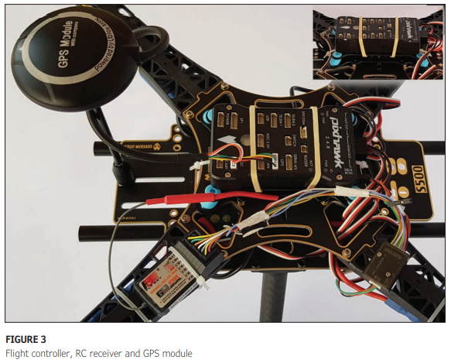
THE HARDWARE BUILD
Step 3: Flight controller, RC receiver and GPS module. The spinning motors and propellers in the quadrotor generate a certain amount of mechanical vibration that is detected by the accelerometer and gyroscope sensors in the flight controller. This vibration is noise to the sensors, and can potentially affect the quadcopter’s stability. To minimize it, the flight controller can be installed on top of an anti-vibration mount, as shown in Figure 3. We initially used rubber bands to fix the flight controller to the antivibration mount. In the final steps, it will be fixed with double-sided tape.

Slide 44
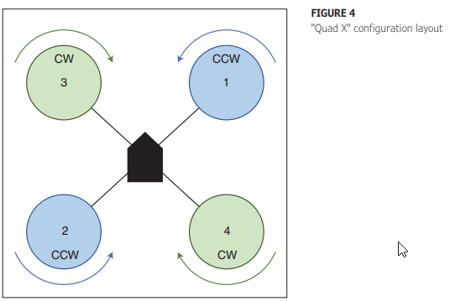
THE HARDWARE BUILD
Figure 4 shows the motor layout for a "Quad X" configuration. Each motor has a given number, position and rotation direction, so it is critical to connect their corresponding ESC signal cables to the flight controller’s outputs in the given order. Tip #4: The correct layout of all motors in the frame and connection of ESC input signal cables to correct output pins in the flight controller are of utmost importance. Failing to do this can make the quadcopter behave erratically and ultimately crash

Slide 45
THE HARDWARE BUILD
For this build, We used a conventional 6-channel remote control (RC) system with parallel analog PWM outputs. The Pixhawk controller, however, just accepts serial PPMSum or S.Bus input signals, which provide all RC channel signals via a single serial digital output. You can purchase an RC system with a serial output receiver suitable for connecting directly to the Pixhawk. Nevertheless, if you have a system with parallel analog PWM channels, low-cost parallel analog PWM-todigital serial converters, such as the one We used for this build, are available. The connection of the GPS and external compass module is straightforward. The module has two connectors. The wider one is for the GPS receiver, and the narrow one for the digital compass. The digital compass is highly sensitive to magnetic interference. With that in mind, a stand for the GPS module is generally recommended to avoid interference from the rest of the electronics, especially the power system. Figure 3 shows the flight controller, RC receiver and GPS module with its stand.

Slide 46
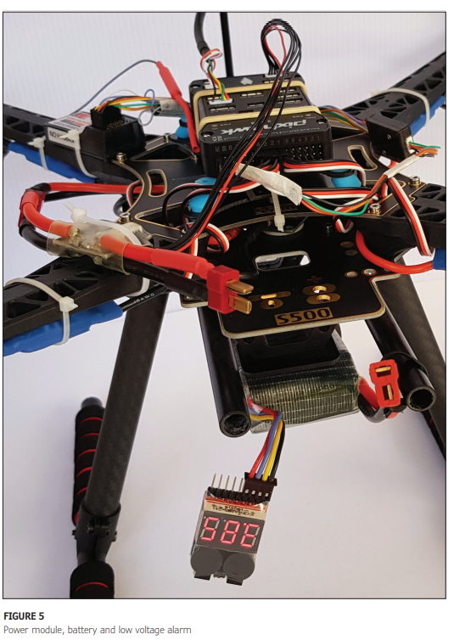
THE HARDWARE BUILD
Step 4. Power module, battery and alarm. The power module connected to the flight controller and the PDB, as well as the LiPo battery in place with its low voltage alarm, are shown in Figure 5.
The connection between the flight controller, power module, battery and propulsion system are illustrated clearly in Figure 1, so go back to this at any time to get a more detailed view of other connections. To fly this quadcopter, We’m using a 5,000mAhour, 3S, 8C battery. Tip #5: Improper use of LiPo batteries can be extremely dangerous. Before charging, connecting and using them, take the time to thoroughly research their use and care. Many resources on the Wenternet cover this topic in detail.

Slide 47
Telemetry
Step 5. Telemetry module, gimbal and FPV (first person view) transmitter. The telemetry module must be connected to the TELEM1 port in the Pixhawk (Figure 1). The gimbal receives power from the power distribution board. Mine can work with LiPo batteries between 2S and 6S. Gimbals generally have a signal input to manually control the camera pitch angle. This input can be connected to any unused output in the RC receiver, preferably one from a channel associated with a knob in the RC transmitter. Once the gimbal is powered on, the camera should be automatically stabilized, and the pitch angle controlled with the associated knob in the RC transmitter. Drone cameras
have a video signal output to be connected to the FPV video transmitter (powered also from the PDB). Usually, the FPV system is separated from the drone system itself (Figure 1).
Step 6. Finishing the hardware build. We usually connect the battery once at the end of the hardware build, to be sure everything is okay and nothing is getting hot due to a short circuit, especially in the propulsion system. Then, We proceed to tighten all screws with threadlocker glue. We take them out one by one from the frame and motors, apply threadlocker and tighten them well in place again. Threadlocker needs at least 24 hours to properly cure. We use Loctite Threadlocker Blue, which is recommended for multirotor builds.

Slide 48
Telemetry
Tip #6: After your first flight and before flying again, always check that the motor and frame screws are still tight. Sometimes they can loosen, because parts tend to settle further with mechanical vibration, and the screws would need to be tightened again. A loose motor or frame part can make the quadcopter vibrate too much and make it crash.

Slide 49
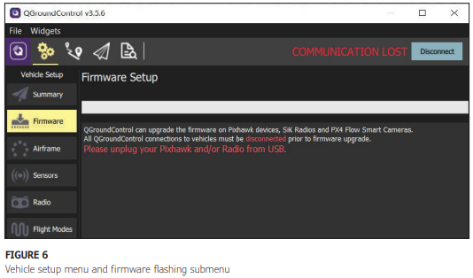
THE FIRMWARE
Although We’m using PX4 firmware for this build example, the same quadrotor setup can also be flashed with Ardupilot firmware by following a similar set of steps, such as the ones outlined as follows:
Step 1. Firmware flashing. It is really easy to flash the firmware to the flight controller by using ground control software. With QGroundControl, you can do that by going to the “Firmware” submenu located in the “Vehicle Setup” menu (Figure 6) and following the instructions given there.

Slide 50
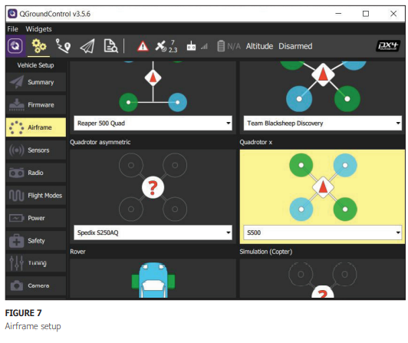
THE FIRMWARE
After flashing the PX4 firmware, the frame type must be configured in the “Airframe” submenu, under the “Quadrotor x” option. We chose the "S500" for this build (Figure 7).

Slide 51
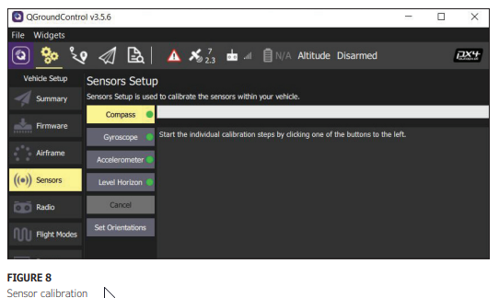
THE FIRMWARE
Step 2. Sensor calibration. Next, from the “Sensors” submenu, we calibrate the compass, gyroscope and accelerometer, and also level the horizon (Figure 8). Plenty of guidelines are given in each step by QGroundControl, itself.

Slide 52
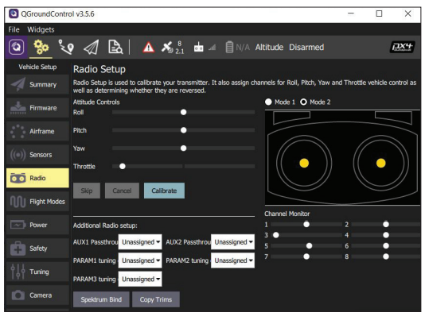
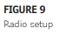
THE FIRMWARE
Step 3. Radio setup. The radio calibration, done in the “Radio” submenu (Figure 9), ensures that the minimum and maximum values for each RC channel are correctly set in the flight controller. These values generally vary from one RC transmitter to another. useful flight modes We can recommend for beginners are Altitude, Position and Return. Altitude automatically stabilizes the quadcopter’s altitude by using the barometric pressure sensor (altimeter), but it doesn’t stabilize position in the horizontal plane. This is because this flight mode does not use the GPS receiver. It requires you to stabilize the quadcopter in the horizontal plane manually, which can be tricky for beginners, especially with strong winds. Wen this mode, the quadcopter can be armed without the need for GPS fix (useful for indoor motor testing).

Slide 53
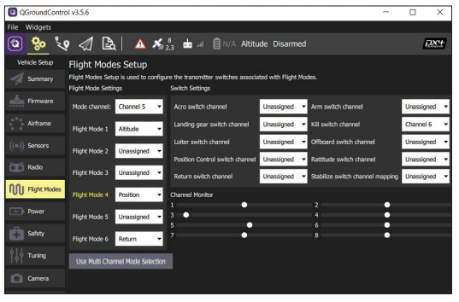
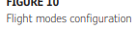
THE FIRMWARE
Step 4. Flight modes configuration. In the “Flight Modes” submenu (Figure 10), we can configure up to six different flight modes. With a 6-channel RC, We generally assign channel 5 for controlling the flight modes and channel 6 for the “Kill switch” function. The three most

Slide 54
THE FIRMWARE
Tip #7: Never fly a quadcopter indoors if you are a beginner, or if there are people around. For your flight tests, always use big, open fields without people, animals or obstacles around

Slide 55
THE FIRMWARE
Position is the preferred flight mode We recommend for beginners, especially for flying in windy conditions, because it uses the barometric pressure sensor and also the GPS receiver for stabilizing the drone vertically and horizontally. But it doesn’t allow arming the motors and drone take-off without a good GPS fix, which you won’t get unless the GPS receiver has good sky visibility. Return flight mode automatically returns the drone to the home position, and is useful if, for some reason, you lose control, and just want the flight controller to take over and land the drone by itself at the original takeoff spot. Finally, it is also important to configure the “Kill switch” function to turn off the motors, especially when something goes awfully wrong. For example, if the drone falls down to the ground and the motors are still spinning, even with the throttle stick at zero—or when the drone is out of control and it is better to switch it off (and crash it) before anything worse happens.

Slide 56
THE FIRMWARE
Step 5. Power setup. In the “Power” submenu, the flight controller’s battery power monitoring function can be configured, so it can accurately estimate the remaining power and flight time. We generally just configure the “Number of cells” parameter (“3S” for a 3S battery), and leave the rest at their default values. At first, it's better not to change the remaining parameters, until you understand well how these parameters affect the way the flight controller does the aforementioned estimations. S

Slide 57
THE FIRMWARE
Step 6. Failsafe actions. A “failsafe action” is a predefined safety measure the quadcopter will take when some types of failures occur. Examples of failures include when the battery is at its minimum, when the RC signal is lost, or when the data link (telemetry) is lost. Available options for safety measure configuration range from doing nothing or giving a warning, to landing the drone, returning it to home or hovering it in place. Failsafe actions can be configured in the “Safety” submenu. The default options are also a good starting point

Slide 58
ESC CALIBRATION & PRE-TESTING
One last important step to take before the first flight is ESC calibration (available from the “Power” submenu). ESC calibration ensures that all motors respond equally to the available throttle range from the RC transmitter. This is accomplished by teaching the ESCs to recognize the minimum and maximum PWM values for zero and full throttle.
Tip #8: Before attempting to take off for the first time, check the rotation direction of all motors according to what’s specified in the layout for the selected configuration. Also check the correct propeller mounting. Motors spinning in the wrong direction, or propellers incorrectly mounted will cause erratic behavior, ranging from not being able to take off at all, to taking off and spinning uncontrollably in the horizontal plane, or taking off and turning upside down and ultimately crash.

Slide 59
ESC CALIBRATION & PRE-TESTING
If a motor spins in the wrong direction, swap two of the three motor cables connected to the ESC (any two of the three available) to change the rotation direction. Also verify the proper propeller mounting, with the upper and lower cambers correctly positioned, and the leading edge “cutting” right into the air, in the right rotation direction

Slide 60
FLIGHT TESTS
Until this point, for safety reasons, always do all motor pre-tests without propellers, and put the propellers on the motors just before the first flight. Pick an open field with no people, animals or obstacles around. If there are natural or man-made obstacles (such as tall trees, hills, buildings or towers), the GPS receiver will take longer to get a fix, or worse yet, it will lose it intermittently during flight.
Tip #9: Always try to do your flight tests in the morning, when the wind is generally calmer than in the afternoon. Avoid flying in relatively strong winds until you develop good piloting skills. You can carry a pocket anemometer to measure wind speed before taking off

Slide 61
FLIGHT TESTS
The maximum wind speed in which a quadrotor can be safely flown depends on the quadrotor’s maximum speed. A good rule of thumb is to set the maximum wind speed at two-thirds or less of the quadrotor’s maximum speed. For example, if the quadrotor’s top speed is 80mph, two-thirds of that is about 53mph. This, according to the rule, will be the maximum recommended wind speed to fly the quadcopter safely. Last but not least, don’t forget to comply with all regulations in place for flying drones in your town, to avoid legal problems.

Slide 62
FLIGHT TESTS
From a functional standpoint, PX4 and Ardupilot are not very different. The processes of flashing firmware and configuring parameters are almost the same in both platforms. Besides, both are MAVLinkcompatible and generally work well with the same quadcopter setup, as long as the flight controller is compatible with both platforms. After you have flashed and configured your quadcopter with, say, PX4, and flown your drone for some time, you can try Ardupilot if you wish. Every step described in the Firmware Flashing and Configuration section of this presentation will also apply, with minimum differences. You can even try to use Mission Planner or APM Planner this time. These are two ground-control software applications from the Ardupilot ecosystem, and are similar to QGroundControl.

Slide 63
MAVSDK AND MAVROS
MAVSDK is a MAVLink library from the PX4 ecosystem that’s written in C++ and has bindings to Python, Swift and Java. It also has bindings to JavaScript, C# and Rust, though still in “proof-of-concept” stage. MAVSDK allows programmatic interaction with any MAVLink-compatible vehicle, to get general information from it, get telemetry data, send action commands like arming, take off, land or return to home, send commands to calibrate sensors and send “low level” commands to directly control vehicle movement [2]. For instance, you can control position, velocity and acceleration in three dimensions, to make the drone change its states in response to decisions made by some type of navigation algorithm

Slide 64
MAVSDK AND MAVROS
In contrast, the MAVROS package (which is an ROS-to-MAVLink bridge, also from the PX4 ecosystem), allows the use of MAVLink communication, to make it possible for any computer running the Robot Operating System (ROS) middleware to communicate with any vehicle or ground-control station software that uses the MAVLink protocol. In summary, MAVSDK will allow you to program a robotic drone, and MAVROS will allow you to do it straight away in an ROS environment, for a more modular, distributed, scalable and professional approach. Ardupilot has also its own MAVLink library, called Dronekit, with available Python and Android APIs. But apparently, not much work has been done lately to provide support for other programming languages.

Slide 65
MAVSDK AND MAVROS
If you want to get started with autonomous flight application development within the PX4 ecosystem, We suggest you try MAVSDK and/or MAVROS in three stages. First, generally the easiest way to try MAVSDK is to install the Python wrapper and try some included examples with a "Softwarein-the-Loop" (SITL) simulator. The C++ version installation can be a little more involved, in some cases requiring building the library from source. MAVROS is useful only if you already know how to use ROS. If you are new to ROS, perhaps you should first learn ROS, before trying MAVROS. But you still can make your drone fly autonomously by using MAVSDK. Both MAVSDK and MAVROS can connect to vehicles via serial port, UDP and TCP connections. When working with a simulation, TCP/UDP connections will usually be the way to connect our software application with the simulator.

Slide 66
MAVSDK AND MAVROS
Second, once your code runs well on simulation, you can try it on a real drone by opening the telemetry module serial port from the application running on your development computer or mobile device. In this case, MAVSDK and MAVROS will communicate with your drone by using the MAVLink connection established via the telemetry modules.

Slide 67
MAVSDK AND MAVROS
Third and last, to make your drone truly autonomous, you can upgrade your system by adding a companion computer (Raspberry Pi, Odroid, Jetson Nano or others) to your quadcopter setup. The companion computer can be connected directly to the TELEM2 serial port of the flight controller to run the MAVSDK/ MAVROS code that controls the vehicle, along with some other code interfacing with additional sensors and actuators especially suited for your application

Slide 68
CONCLUSION
We hope the information presented in this two-part presentation series gave you a general perspective about the PX4 and Ardupilot platforms, and what is involved in building a quadcopter for aerial photography, or perhaps more interesting, for experimenting with autonomous flight. If you have never built a quadcopter before, We really encourage you to do it and experiment. We’m not going to lie, you’ll crash many times while learning to pilot it and experimenting with it, but that’s the normal learning process for anyone. Still, it is a lot of fun! Most excitingly, once you get a good grasp of what’s involved in building and configuring a quadcopter properly, you can begin to experiment with autonomous drone applications.
Wen a future follow-up to this presentation, We will cover in more detail—and with a concrete example—how to use the MAVSDK library to develop code for autonomous drones using SITL simulation.

Slide 69
Break
8:54 – 9:04
Examples of the MAVSDK use for simulation and real drone
Write your initials autonomously
Updates on project – questions
Homework

Slide 70
Part 3. Writing MAVSDK/PX4 Drone Applications
DEVELOPMENT TOOLCHAIN
RUNNING BASIC EXAMPLES
PYTHON ASYNCHRONOUS PROGRAMMING
COORDINATES AND ANGLES
AUXILIARY FUNCTIONS
RUNNING ON A REAL DRONE

Slide 71
Writing MAVSDK/PX4 Drone Applications Autonomous Flying FuN
In this presentation, We share a quick introduction to drone applications development with the MAVSDK MAVLink library and the PX4 autopilot ecosystem. We also discuss how to set up a development environment in the Ubuntu operating system by installing a basic toolchain that includes the PX4 Software-InThe-Loop (SITL) flight stack, jMAVSim and Gazebo simulators, MAVSDK-Python (which is the Python wrapper for the MAVSDK core C++ library) and QGroundControl ground station software.
We then explain how to write your first quadrotor autonomous flight application, by showing an example in which the vehicle basically follows a predetermined path to write your name initials in the air. SITL simulation is used to run the example, but We also discuss briefly how to run it with a real drone.
This presentation is a follow-up to our two-part presentation “An Introduction to Ardupilot and PX4” which was a general introduction to quadrotor drones and the PX4 platform.
Although it is intended for beginners who never experimented with drone autonomous flight and/or the MAVSDK library, it will require that you have at least general introductory knowledge on how quadcopter drones work, the PX4 flight controller software ecosystem— including the MAVLink protocol and QGroundControl—and, of course, the Python programming language.

Slide 72
DEVELOPMENT TOOLCHAIN
Mac OS, Linux and Windows operating systems are officially supported for PX4 development. Having tried the toolchain installation in Windows and Linux (unfortunately not in Mac OS), We found that Windows is not really recommended for beginners. That's because the installation process can be cumbersome, unless you have previous experience setting up compiling environments in Windows. The Linux installation seems to be easier and has better official support. Apparently, Linux is used extensively as a preferred platform for PX4 development. The custom example presented in this article was tested in Ubuntu 18.04, both natively and also in a virtual machine using VirtualBox in a Windows host. It should work in Ubuntu 16.04 as well. A Docker container with the development toolchain installed beforehand is also available. However, at the time of publishing this article, it was only supported for Linux.

Slide 73
DEVELOPMENT TOOLCHAIN
Now let's look at how to set up the development toolchain in Ubuntu 18.04. It will include the PX4 SITL flight stack with the jMAVSim and Gazebo simulators, the MAVSDKPython library and QGroundControl ground station software. We will not go into minute detail on all the steps involved. That said, there’s a text file INSTALL_RUN_SIMULATION md included with the source code for this article that describes all the steps We took to install the toolchain. It also contains links to PX4’s official pages covering detailed procedures. All such files are available on code and files folder.
If you only have a Windows machine on hand, you can use VirtualBox to create a virtual Linux Ubuntu machine inside Windows.

Slide 74
DEVELOPMENT TOOLCHAIN
Once you have your Ubuntu operating system ready, follow these steps to set up the development toolchain
First, install the PX4 SITL jMAVSim/Gazebo simulation environment. There may be some prerequisites, check the INSTALL_RUN_ SIMULATION.md text file for detailed steps. After the installation is complete, the procedure will leave you at the default compilation subdirectory, which is ~/src/ Firmware. From this subdirectory you can compile and run the PX4 SITL flight stack with both jMAVSim and Gazebo vehicle simulators. For instance, to compile and run PX4 SITL with Gazebo, in the same command terminal run make px4_sitl gazebo. Wet is possible the compilation may fail due to some missing libraries in your Ubuntu Installation. Check the WeNSTALL_RUN_SIMULATION.md file on how to fix some compilation errors you might get

Slide 75
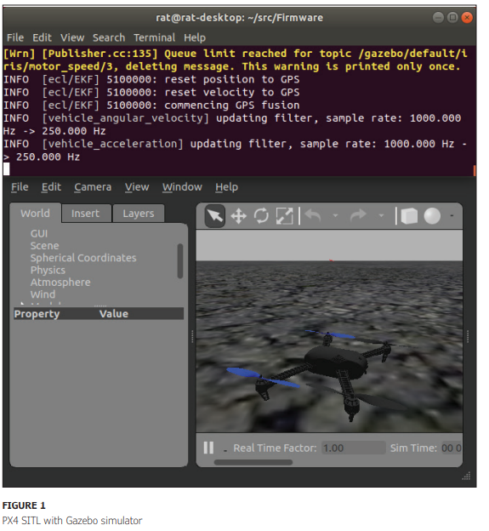
DEVELOPMENT TOOLCHAIN
Once the compilation finishes without errors, the Gazebo simulator will start and show a simulated 3DR Iris+ quadcopter (Figure 1). In the same command terminal, run commander takeoff, and you will see the drone begin to take off to a default altitude. In some cases, the quadcopter will land by itself after a few seconds. If not, run commander land to make it land to its home position. To stop the simulation, press in the command terminal. You can try PX4 SITL with the jMAVSim simulator as well, by running make px4_sitl jmavsim. Figure 2 shows the jMAVSim simulation after commander takeoff has been executed.

Slide 76
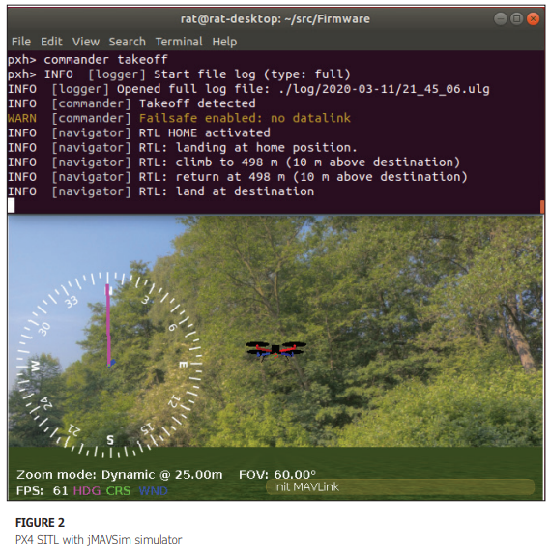
DEVELOPMENT TOOLCHAIN
Next, Install MAVSDK-Python. Download and install QGroundControl and clone the MAVSDK-Python GitHub repository to run the examples described in the next section. These last steps are straightforward (see the INSTALL_RUN_SIMULATION.md file for details). Wef you managed to get up to this point, you are ready to try some Python code to make the quadcopter fly by itself

Slide 77
RUNNING BASIC EXAMPLES
Let’s try some examples from the MAVSDK-Python repository we have just cloned. First, run one of the two simulators (for instance, you can run make px4_sitl gazebo). Second, run the QGroundControl ground station software. Third, open another command terminal window and run cd ~/ MAVSDK-Python/examples to go to the MAVSDK-Python’s examples directory (assuming you cloned MAVSDK-Python in your home directory). Next, run python3 takeoff_and_land.py to try the "take off and land" example. You should see the quadcopter take off first, and then land automatically after a few seconds. Figure 3 shows this example running. If this worked well for you, then you have the toolchain correctly installed in your machine

Slide 78
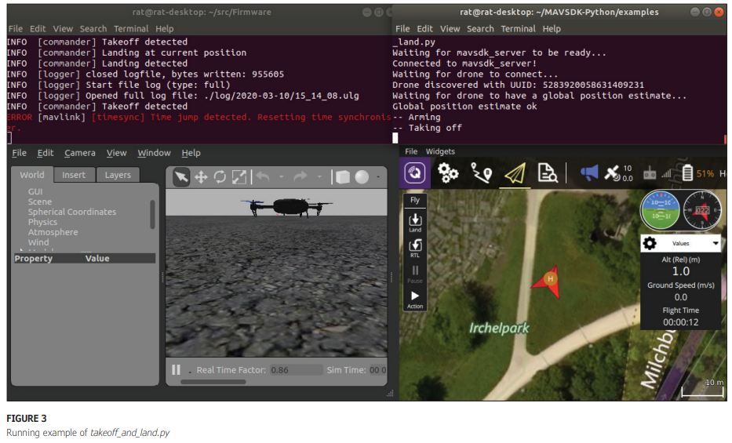
RUNNING BASIC EXAMPLES
In a similar way, you can also try the example offboard_position_ned.py, which gives the drone some navigation coordinates in their local coordinate frame. Run the command python3 offboard_position_ ned.py to try this example as well. If you check the code for the offboard_ position_ned.py example, you will notice that the code lines in charge of commanding the drone to a certain pose look like this: await drone.offboard.set_position_ ned(PositionNedYaw(5.0, 10.0, -5.0, 90.0))

Slide 79
RUNNING BASIC EXAMPLES
Note that the set_position_ned() function is being used to command the drone, and the arguments it receives are coordinates in the "North, East, Down" (NED) coordinate system. So, the first number in the argument (5.0) is the distance along the northern axis, the second number (10.0) is the distance along the eastern axis and the third number (-5.0) is the altitude. If the altitude is negative, it means the drone will actually climb up, because in NED, "Down -5.0" is really "Up +5.0." Altitudes and distances are in meters. The fourth number (90.0) is the desired "bearing angle" in degrees for the drone, once it reaches the desired position. Bearing angle is the angle around the drone’s vertical axis, known also as the "yaw" angle. Therefore, the PositionNedYaw() function will take these four numbers as arguments and convert them to a data structure of type PositionNedYaw, which is defined and used in the MAVSDK library for poses in the NED coordinate system. NED and another variant called ENU ("East, North, Up") are two geographical local coordinate systems used for aircraft navigation. Their axes are oriented along the geodetic directions defined by the Earth's surface, with their origins fixed at the aircraft’s center of gravity [1]. Both follow the “right hand” rule.

Slide 80
PYTHON ASYNCHRONOUS PROGRAMMING
Another characteristic also worth noting in the examples we just ran is the use of the asyncio Python library and its corresponding async /await keywords. Even if you have programmed in Python before, there’s a chance you never used the asyncio asynchronous programming library. When using this library, the async keyword lets us declare an asynchronous function, typically called a “coroutine.” A coroutine is basically a function that execution can be paused at some point— generally, to wait for some event or data on which their subsequent execution depends. In other words, asynchronous functions can stop to wait for some kind of event, but without blocking other tasks in the same program [2]. So, the Python asyncio library with its async/await syntax enables concurrent asynchronous programming. Wen summary, you declare a function async to make it a coroutine, and in some part of its body, by using the await keyword, the function cooperatively hands the control back to the event loop. It then waits for some external event to occur—such as the arrival of data it needs to resume its task, or a returning value from another function.

Slide 81
WRITE MY INITIALS
The custom example, write_my_initials.py that We've prepared for this article is based on the offboard_position_ned.py and telemetry_ takeoff_and_land.py examples found in the MAVSDK-Python/examples folder. In the write_my_initials.py example, we will make the drone autonomously follow a certain path to write in the air the first initials of our name. For the sake of the example, we will write Circuit Cellar magazine’s initials (CCM), but you can later modify the code to write any letters you want. Let’s see what We did to accomplish this task.

Slide 82
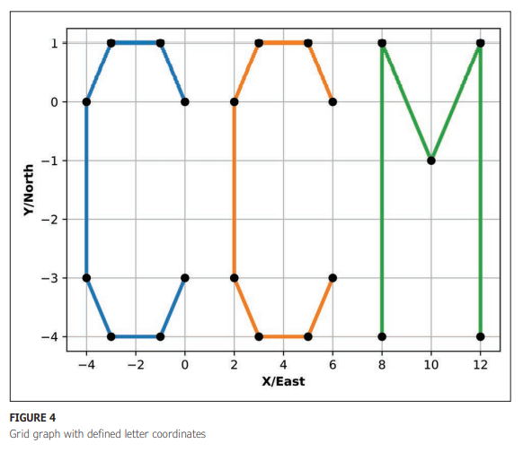
WRITE MY INITIALS
First, We drew the "CCM" initials on a grid paper and determined the minimum amount of points required to clearly define them. Figure 4 shows how the drawing looked. The graph’s scale is 1m per division. So, every letter is 4m by 5m in size. All defined points are in an XY Cartesian plane. But by adding a fixed 5m altitude to each one of them, we get all points defined in an XY plane that is 5m above the ground. We could also think of them as defined in an XYZ Cartesian coordinate system, with all points having the same Z coordinate (Figure 5).

Slide 83
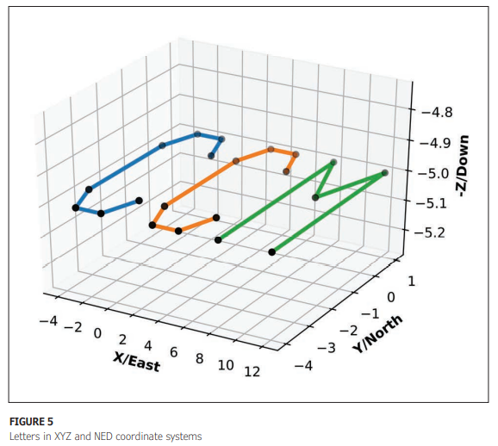
WRITE MY INITIALS
However, because we will also use the set_position_ned() function to command the drone (as in the offboard_position_ned. py example), we need to give the drone all navigation points in the NED coordinate system. For that reason, each of our defined points in the XYZ coordinate system must be mapped to the NED coordinate system. The axis labels in Figure 5 already show how the XYZ and NED coordinate systems are defined, and how their axes correspond to each other.

Slide 84
WRITE MY INITIALS
As you can see, the X coordinate maps to East, the Y coordinate maps to North and Z coordinate to -Down. Much of the initialization code for this example is the same found in the offboard_ position_ned.py example. The program’s "main" entry function is also async def run() (Listing 1), and the first code lines in charge of the initialization steps are selfexplanatory. In code line 10, with drone = System() we instantiate a System object, which in the MAVSDK API represents the vehicle and will allow us to interact with it.
With line 11 immediately below, we are making a UDP connection to the drone, to a default WeP address and port 14540. With "udp://:14540" we expect to find the drone at "localhost:14540." That will be the case when our Python script runs in the same machine as the SITL simulation.

Slide 85
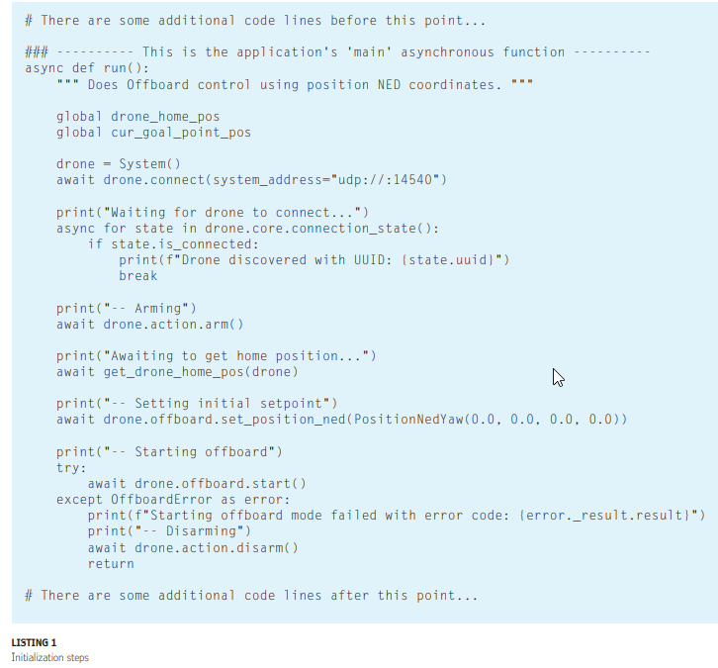
WRITE MY INITIALS

Slide 86
WRITE MY INITIALS
Next, with an async for loop (line 14), we poll the drone’s connection state until a connected state is received. Subsequently, we print the drone’s identifier code (UUID) and break the async for loop—otherwise, the loop would run indefinitely, because in MAVSDK, PX4 telemetry data is provided as continuous streams. Line 20 arms the drone and line 23 lets us wait until we have acquired the home position coordinates (more on the get_drone_home_pos(drone) function later).
Line 26 sets an initial pose for the drone before changing to offboard flight mode in lines 29 to 35. offboard flight mode requires we begin by sending some poses before changing to this flight mode. If, for any reason, the flight mode change fails, the drone is disarmed and a return from the main function is executed to abort the whole program. PX4’s offboard flight mode lets us control the drone by using position, velocity, acceleration (thrust) and altitude setpoint commands via MAVLink.

Slide 87
WRITE MY INITIALS
Listing 2 shows how each one of the three initials are defined as Python lists (actually, as "list of lists"), in which every vertex point for a letter is an inner list of NED coordinates in meters and a bearing angle in degrees. The bearing angle is the angle measured in a clockwise direction from the northern line, and is the angle the drone must have after reaching the given NED coordinates. For instance, a bearing angle of 270 degrees means the drone will be pointing toward the West. In line 3, we have the first "C" letter defined as a list containing eight vertex points.

Slide 88
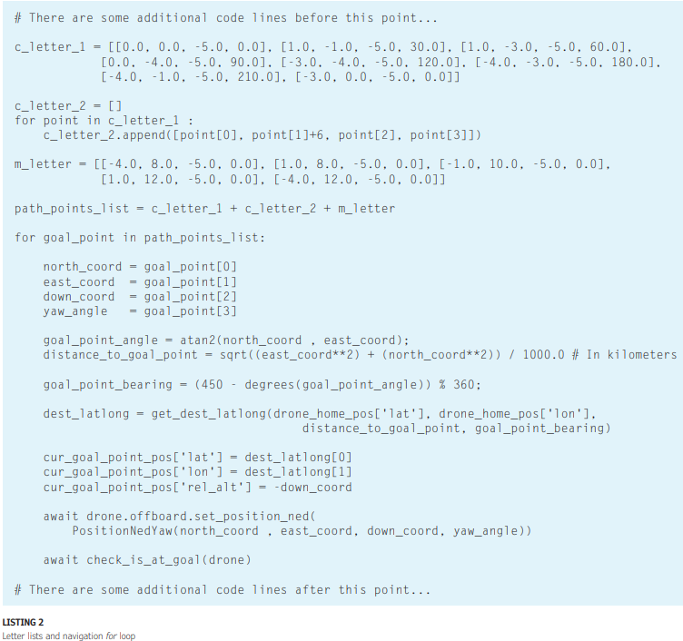
WRITE MY INITIALS

Slide 89
COORDINATES AND ANGLES
The NED coordinates for each point were copied from Figures 4 and Figure 5. The bearing angles were picked at random, so their values don’t have major significance regarding this particular example. For the second "C" letter, in a for loop, We just added 6 to the East coordinate of each point in the first "C" letter, to make a copy of it that's displaced 6 units to the right (see lines 7-9). Figure 4 shows how that makes sense intuitively. For the last letter, "M," defined in lines 11-12, We also copied the coordinates from the grid graph and gave each point a random bearing.

Slide 90
COORDINATES AND ANGLES
In line 14, the three letter lists are concatenated into one list called path_ points_list by using the Python + concatenation operator. Next, in the for loop, we iterate over each point contained in the aforementioned list and make the drone navigate to each one of them in the given order. For instance, to go to the current point, in lines 18-21, first we retrieve the North, East and Down coordinates, along with the bearing angle.
Then, in lines 23-24, we calculate the point’s angle with respect to the East and its horizontal distance from the origin (the drone’s initial position), by using the arctangent trigonometric function and the Pythagorean formula, as if we were in the XY Cartesian plane (Figure 6).
Then, in lines 26- 29, we convert the point’s angle (with respect to the eastern axis) to bearing (with respect to the northern axis), and with the bearing, the distance and the drone’s home latitude and longitude, we call the get_dest_latlong() function to calculate the GPS coordinates for the current goal point.

Slide 91
COORDINATES AND ANGLES
Because the drone’s distance to current goal will be measured in the async def check_is_at_goal (drone) function (more on this function later), to check if the drone has reached the current goal point, we populate the cur_goal_point_pos global variable (a Python dictionary, actually) with the current goal’s latitude, longitude and altitude. Next, in line 35 we call the drone. offboard.set_position_ned() function to set the current NED coordinates and Yaw angle as the next drone pose. The await keyword in this line ensures the for loop will pause until the drone receives this new goal pose. Finally, in line 38 we call the check_is_ at_goal(drone) function, which will return after the drone reaches the current goal point. Figure 7 shows a screen capture of the write_ my_initials.py example running.

Slide 92
AUXILIARY FUNCTIONS
Listing 3 shows the two asynchronous auxiliary functions that are part of write_my_ initials.py. Let’s explain what these functions do. The first function, async def get_ drone_home_pos(drone) is in charge of obtaining the drone’s home position GPS coordinates and relative altitude. With the async for loop in lines 5-11, this function starts iterating over the "home" position incoming telemetry stream, and after receiving the first reading and storing it in the drone_home_pos Python dictionary, in line 11 the function returns. The home position is the spot at which the drone takes off, and it won't change during the execution of our Python script, so we need to read it just once at the beginning. If you remember, we call this function in the initialization steps in the main async def run() function (see line 23 in Listing 1)

Slide 93
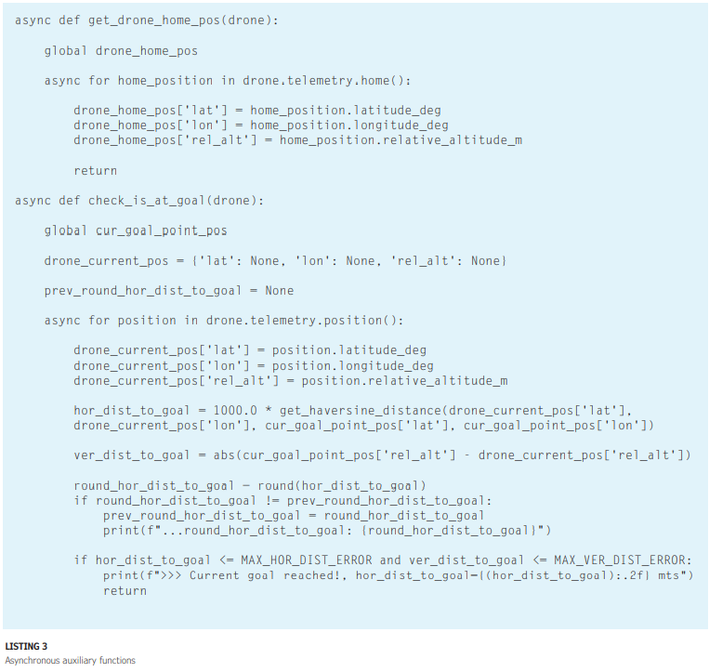

Slide 94
AUXILIARY FUNCTIONS
The second function, async def check_ is_at_goal(drone), is in charge of monitoring the drone’s progress to the current goal point. To achieve this, it iteratively reads the drone’s current position by calling the drone.telemetry.position() function in the async for loop (line 21). After obtaining the drone’s current position, the latitude, longitude and relative altitude are stored in the drone_current_pos Python dictionary (lines 23-25). In line 27, it computes the horizontal distance in meters between the drone’s current position and the current goal’s position by using the get_haversine_ distance() function. The "Haversine" formula used in the latter function allows to calculate "circular distances" (arcs) over the Earth’s surface between two sets of latitude and longitude coordinates. In line 30, we compute the vertical distance as well, which will be useful when the drone is going to a point in a different altitude than the previous one. Then, with the first if sentence (line 33), we check if the drone has reduced the horizontal distance to the current goal in at least 1m, and print the current (rounded) distance value to the terminal window, just for the purpose of visualizing the drone’s horizontal navigation progress. With the second if sentence (line 37), we check if both the horizontal and vertical distances to the current goal are less than or equal to the maximum allowed distance errors MAX_HOR_ DIST_ERROR and MAX_VER_DIST_ERROR, to consider the current goal point reached. Wef this is true, after printing a message, the function returns to the main caller function, in which the for loop in charge of controlling the navigation (see line 16 in Listing 2) will pick the next point and command the drone to go to it.

Slide 95
RUNNING ON A REAL DRONe
This very same example can be run with a real quadcopter drone connected to the PC via telemetry modules, after changing line 11 in Code Listing 1 for: await drone.connect(system_ address="serial:///dev/ttyUSB0:57600") where /dev/ttyUSB0 is the port name assigned by your Linux system to the USB telemetry module connected to your PC. Obviously, in this case you don’t need to run the Gazebo or jMAVSim simulators anymore, nor will you be able to use QGroundControl. If QGroundControl is open, it will automatically connect to the drone by opening the USB serial port, and your Python script won’t be able to open the same port to connect to the drone. You can first use QGroundControl to check if the drone connects properly with your computer via the telemetry modules, and then close it before running the Python script. Please, bear in mind We could be leaving out some additional details (beyond the scope of this article) for the process of running MAVSDK-Python code to control a real drone. The point We’m trying to make here is that, in general, once you have some application correctly running in simulation, testing it with a real drone won’t require making major changes to the code you wrote and software tools you've been using. Nevertheless, We don’t recommend running this example with a real drone, unless you have at least relatively good experience configuring and flying real quadcopters, and you really understand how PX4 flight modes work. However, if you do want to run it with a real drone, We recommend you first try a simpler example such as takeoff_and_land.py to be sure your workflow is okay. Also, remember to consider all the required space the drone would need to cover the whole flying path.

Slide 96
CONCLUSIONS
We hope you saw how relatively easy it is to get into autonomous drone application development with MAVSDK-Python. Sure enough, you have to know Python beforehand and also get the toolchain installed and working properly. And because MAVSDK-Python uses the asyncio library, you also need to have some familiarity with asynchronous programming— nothing fancy, just a general understanding of how concurrency works and specifically how to use the async/await keywords. If you want to further experiment with the MAVSDK-Python API, there are a couple of things you should do. First, get access to PX4’s "Slack" workspace and "Discuss" forum [3], where you can get support for all things related to the PX4 ecosystem, not just MAVSDK. Second, try to study all the examples included in the MAVSDK-Python repository.
Some of them are intuitive and easy to understand, whereas some others would require you to research a bit more. Read the MAVSDK API documentation as well, for a detailed reference about the API’s functions and data structures used in the examples. Wen follow-ups to this article, We will be presenting some more advanced examples of autonomous flight with MAVSDK, and also discussing how to upgrade a quadcopter with a companion computer to do autonomous object tracking with computer vision. We will also talk about how to integrate PX4 with the Robot Operating System (ROS), by using MAVROS (the MAVLink-to-ROS bridge).

